Slide 1
Movie Nights
Birmingham City University
CMP7162 Human Computer Interaction
Presented By:
Ciaran O’Dwyer
Simon Morson

Slide 2
Our Application
Idea was to create a video watching application that could be used online with friends.
With this application, HCI designs and concepts could be explored.
Design ideas such as accessibility design of colours and video player layout could also be implemented and improved with this project.
Notes:
Simon

Slide 3
Similar Comparisons
Name | Description | Similarities/Differences
Watch2Gether | Screen sharing website which allows visitors and registered users to watch media online. | Website allows chat and shared videos to be simultaneously watched.
Youtube | Hugely popular video sharing website which allows users to watch and produce videos. Also acts as a platform for social media. | Large database of videos to watch with some livestream chat elements.
Twitch | Video streaming service and social media platform. Originally built for gaming. | Live videos and streams where users can live chat.
Amazon Prime | Movie/TV Streaming subscription based service. Part of an overall package. | Large database of movies and TV shows to watch on demand.
Netflix | Movie/TV Streaming subscription based service. | Large database of movies to watch on demand using a subscription service.
Notes:
Simon

Slide 4
Target Audience
Students - Users who are computer literate, with spare time and money and a desire to watch movies and spend time with their friends.
Parents and Elderly - Users who aren’t computer literate, with some spare time and more money, who are looking for an easier, accessible option for watching movies.
Notes:
Simon

Slide 5
Accessibility Considerations
Main focuses of accessibility:
Colours - Main requirement will be to use a colour scheme that works with variants of colorblindness, and provide an option to adjust if necessary.
Layout - Main requirements will be to provide a clean, simple, intuitive layout that clearly shows what actions the website will perform.
Notes:
Simon

Slide 6
Personas
To gain a greater understanding of our target audience, we have created a number of Personas. These fictional characters have been created inline with our target audience in mind. It’s important to note that the Personas we are about to show you are not real people.
Notes:
Simon

Slide 7
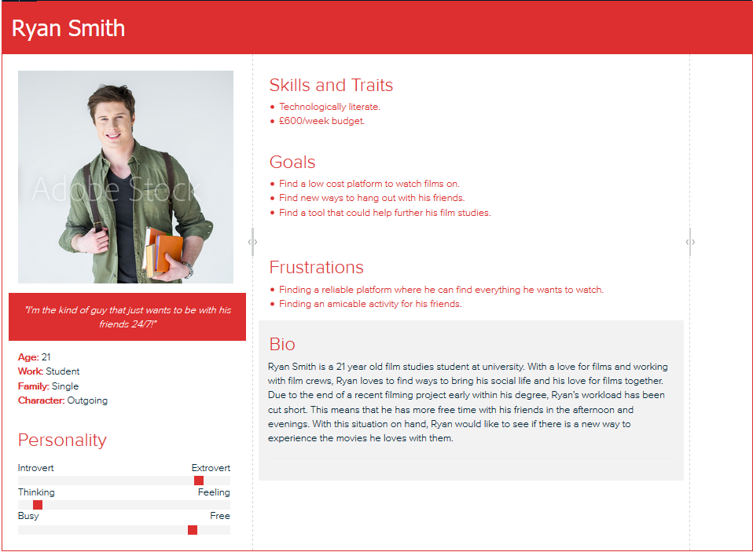
Personas
Notes:
Simon

Slide 8
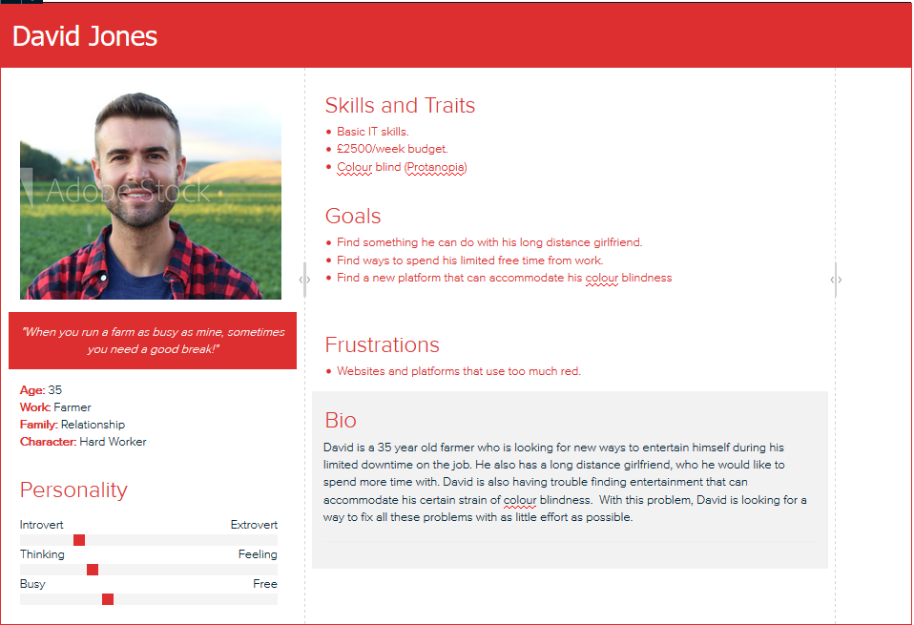
Personas
Notes:
Simon

Slide 9
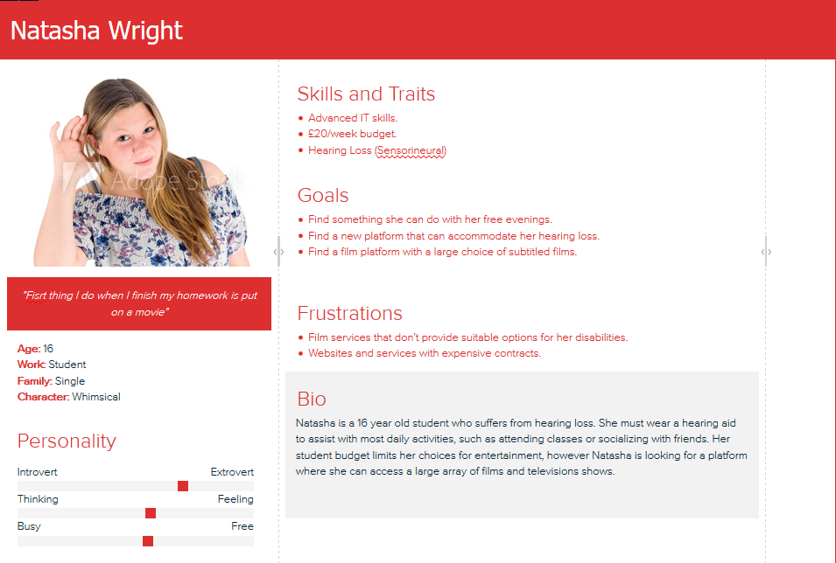
Personas
Notes:
Simon

Slide 10
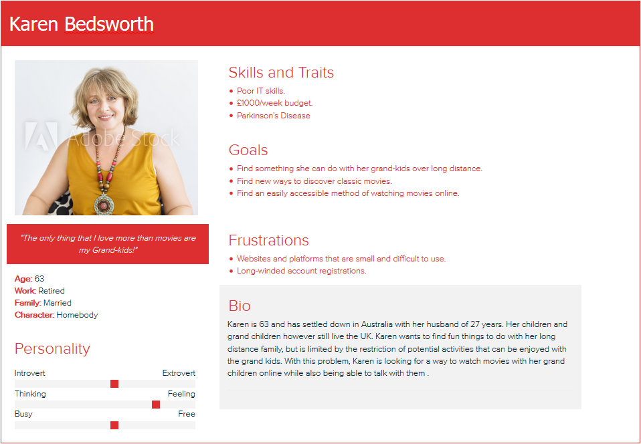
Personas
Notes:
Simon

Slide 11
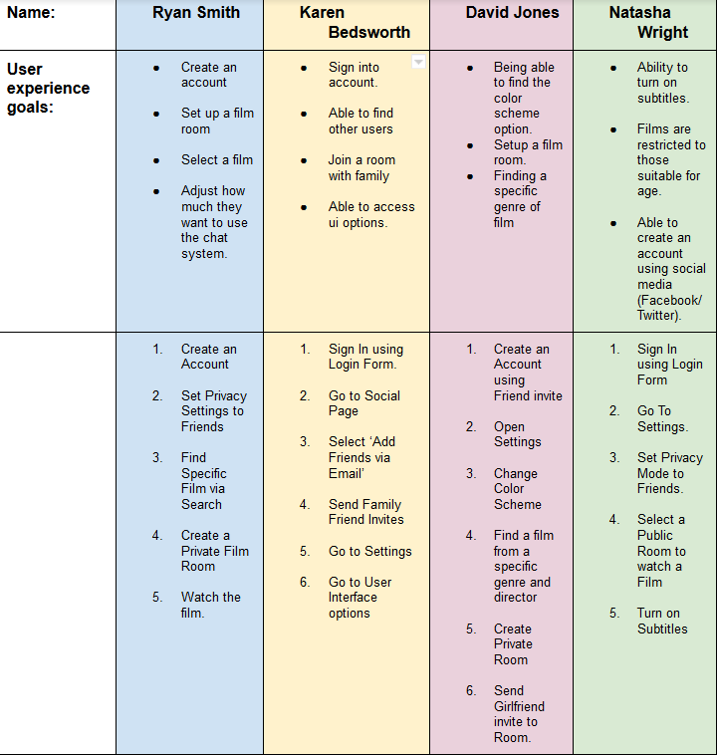
Scenarios
Using the Personas we have created, we have identified a number of likely scenarios for each below. These scenarios will have a number of tasks associated that will need to completed successfully.
Notes:
Simon

Slide 12
Information Architecture
Common Tasks:
Films:
Find Function (Name, Genre, Actors, Director, Language)
Toggle Film Size
Change Volume
Video Actions(Play, Pause, Rewind, Fast Forward)
Rooms:
Create Room (Private/Friends Only/Friends of Friends/Public, Available Types depend on Privacy Settings)
Room Privacy
Chat Preferences (Language, Spoilers(None/Light/Heavy), ON/OFF)
Invite Friends(username, email)
Social Media:
Find Friends (email, username)
Search Users (username, location, age, film interests, films watched)
Message Friend(direct messaging, text message only).
Block/Report Users
Profile:
View(picture, name/nickname, details, age, location, film categories, films to watch, films watched).
Private Settings (name, email, age, location) [Friends Only, Friends of Friends, Everyone].
Settings:
Cancel Subscription/Delete Account
Change Details
Notes:
Simon

Slide 13
Low Fidelity Prototype
The low-fidelity prototypes are a number of paper-based sketches showing the user interface of the Movie Nights system. It is important to note that these sketches are just a preview of what we expected the user interface to look like at this stage of the project.
Notes:
Simon

Slide 14
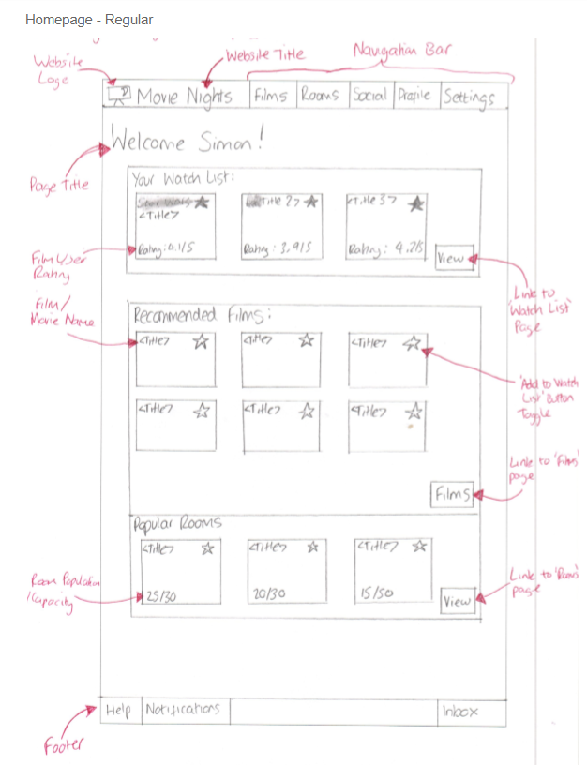
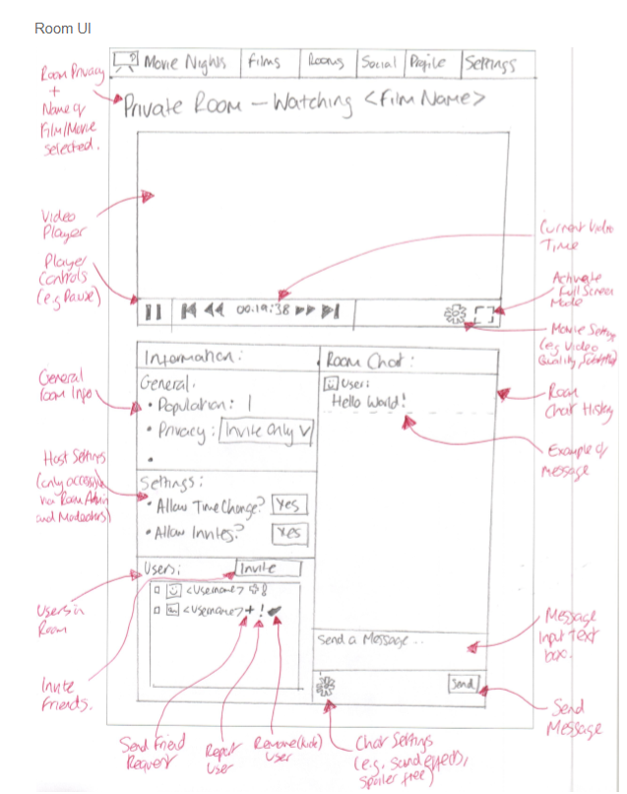
Low Fidelity Prototype
Notes:
Simon

Slide 15
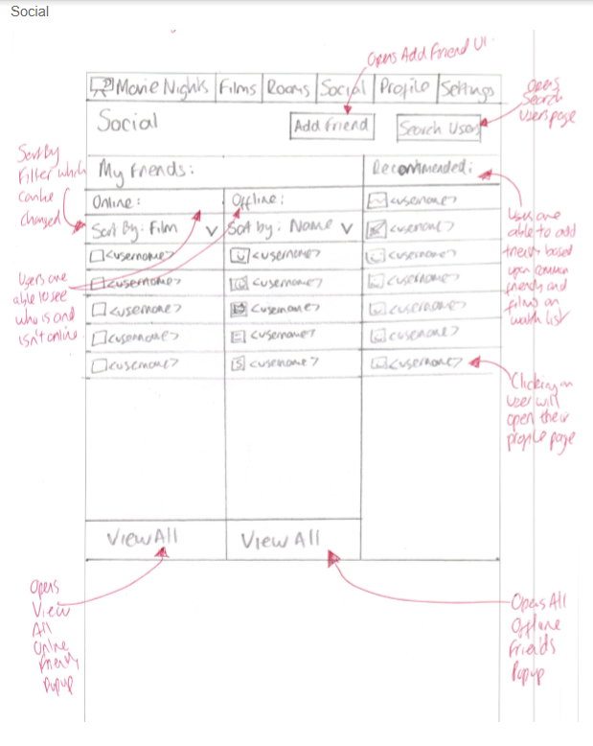
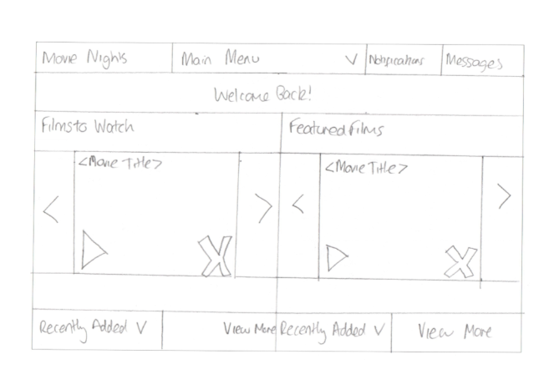
Low Fidelity Prototype
Notes:
Simon

Slide 16
Wireframe Prototype
The Wireframe prototypes were designed using the InvisionApp website. The prototypes were designed using the feedback received from the Low Fidelity Prototypes.
The following slides consist of some example wireframes, with the appropriate low-fidelity prototype to demonstrate the changes that have been made.
Notes:
Simon

Slide 17
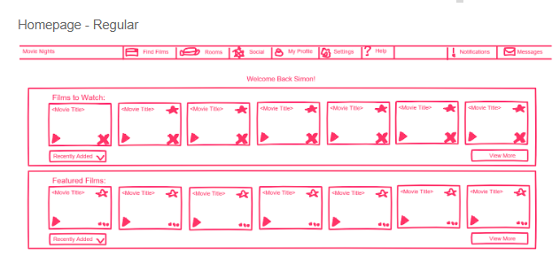
Wireframe Prototype - Homepage
Low Fidelity
Wireframe
Notes:
Simon

Slide 18
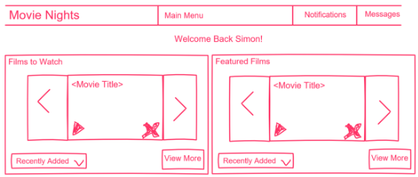
Wireframe Prototype - Homepage(Big Icon Mode)
Wireframe
Low Fidelity
Notes:
Simon

Slide 19
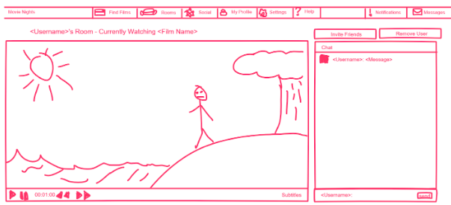
Wireframe Prototype - Room UI
Low Fidelity
Wireframe
Notes:
Simon

Slide 20
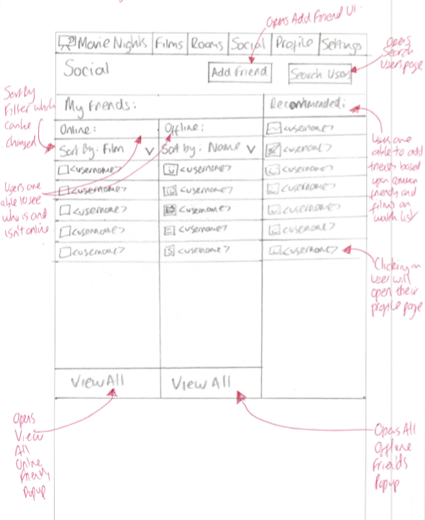
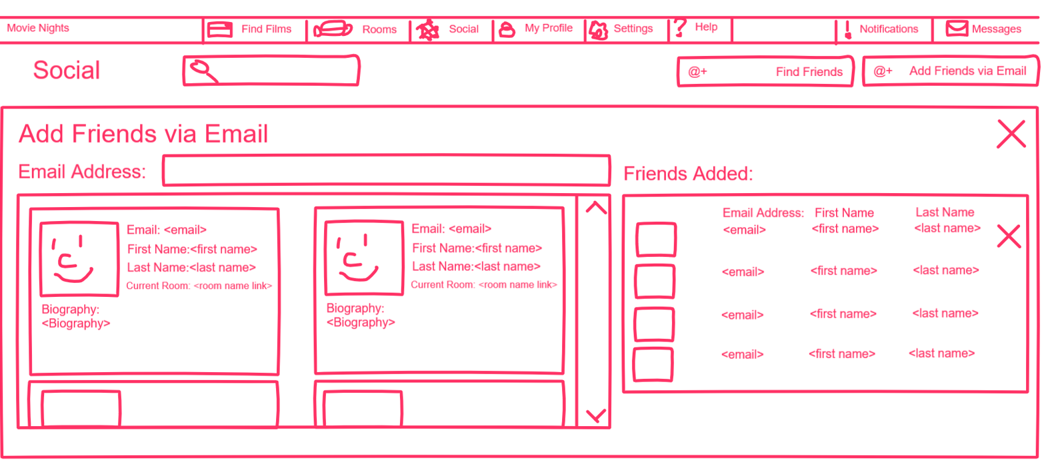
Wireframe Prototype - Social
Low Fidelity
Wireframe
Notes:
Simon

Slide 21
Card Sorting
After reviewing the Wireframe prototype. It was important we were able to get some feedback in regards to what they would expect in a user interface.
Using Optimal Workshop, we experimented with using a card sort method to categorise the amount of options they the system would have to include.
From this testing, we made menus to sort what options should be adjusted where.
Notes:
Ciaran

Slide 22
High Fidelity Prototype
We will now present and demonstrate our High Fidelity Prototype. The Prototype was developed using Adobe XD.
Notes:
Ciaran

Slide 23
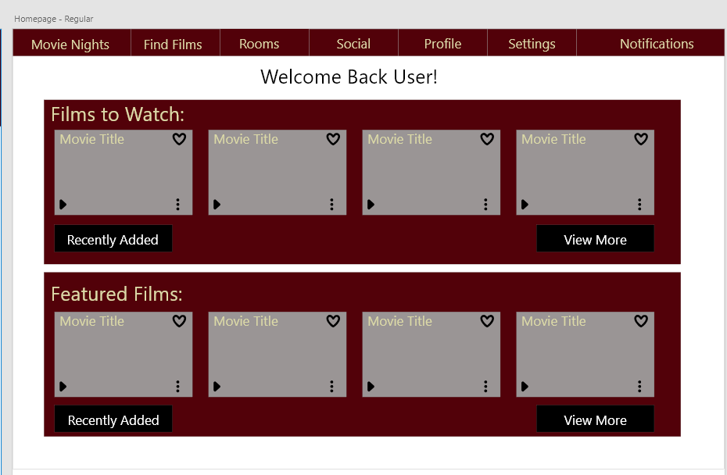
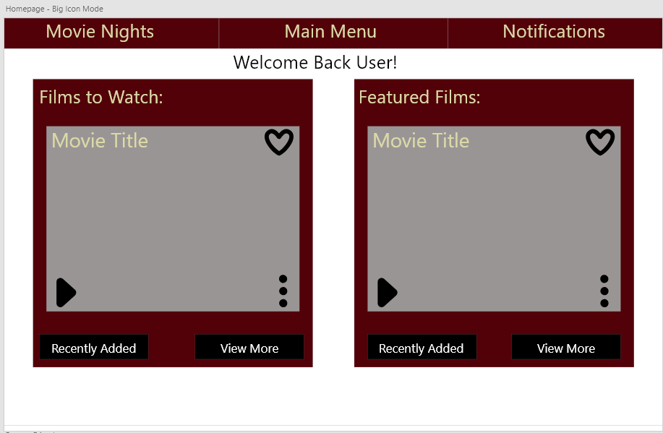
High Fidelity Prototype
Notes:
Ciaran

Slide 24
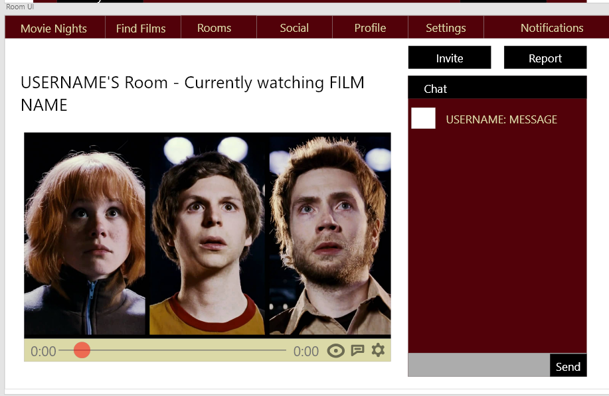
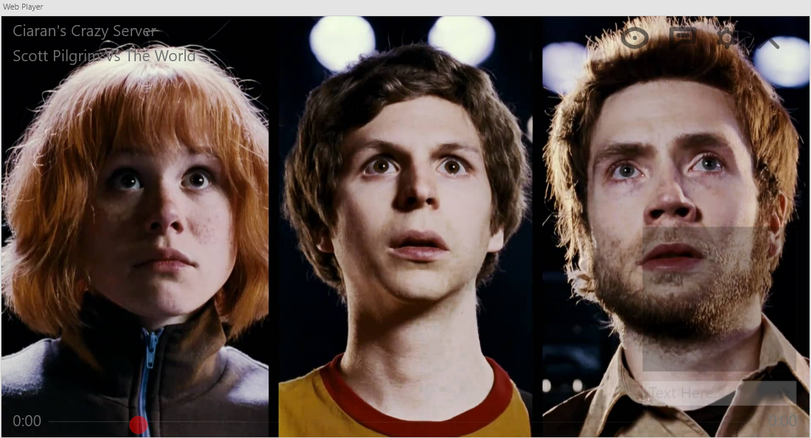
High Fidelity Prototype

Slide 25
Usability Testing
What did we test?
Users were tested on how effectively they could navigate the website.
Users were also tested on their ability to find certain options and features within the website.
Which tasks did we give people?
Users were tasked with accessing all the aspects of the websites as if trying to watch a film.
Users were also tasked with activating accessibility options that the website offered.
Users would then be required to note their thoughts and experience, complete a Qualitative and Quantitative SUS survey.
Who were your participants?
7 participants, with ages ranging from 18 - 30 year olds.
Each participant varied in technological literacy and ability.
Notes:
Ciaran

Slide 26
Usability Testing
Which qualitative and quantitative data did we collect?
Qualitative survey tasked with gathering users thoughts and opinions on the pages, allowing them to report any errors that were encountered and improvements that they would suggest.
Quantitative survey was SUS scale test, a pre-designed survey used as a measuring system of accessibility.
What were our key findings?
From Qualitative survey, users reported enjoying colours and layout, but struggled with confusing buttons and encountered bugs in the page.
From Quantitative survey, users found the system relatively accessible, but reported inconsistency in the system.
How did this inform future iterations of our design?
Surveys informed us to remove any button that may not have a functional use at the time.
Also informed us of how to layout page to confuse the user less.
Notes:
Ciaran

Slide 27
Usability Testing
Here is some evidence of the usability tests that were performed...
“Think Aloud” Test results:
Users reported that they enjoyed the “Simplicity”.
Users also reported that the website used a “Nice choice of Colours”.
Users also liked the “chat options”.
Some users experienced confusion with which buttons to use.
Several users experienced an error with the registration page due to a design fault.
Notes:
Ciaran

Slide 28
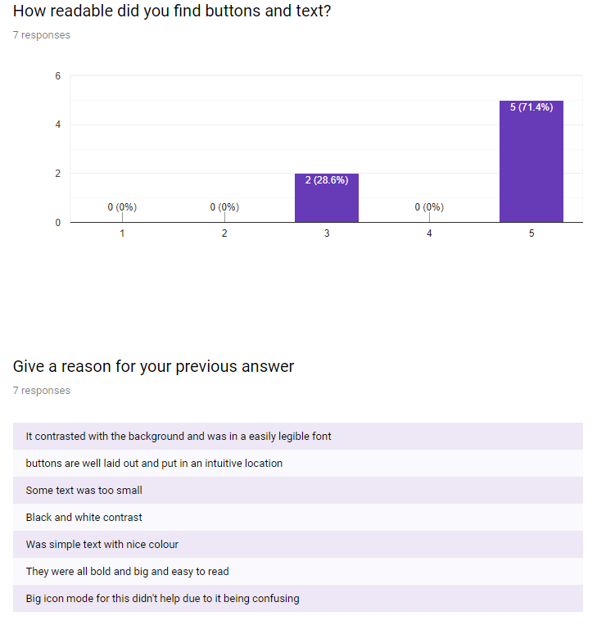
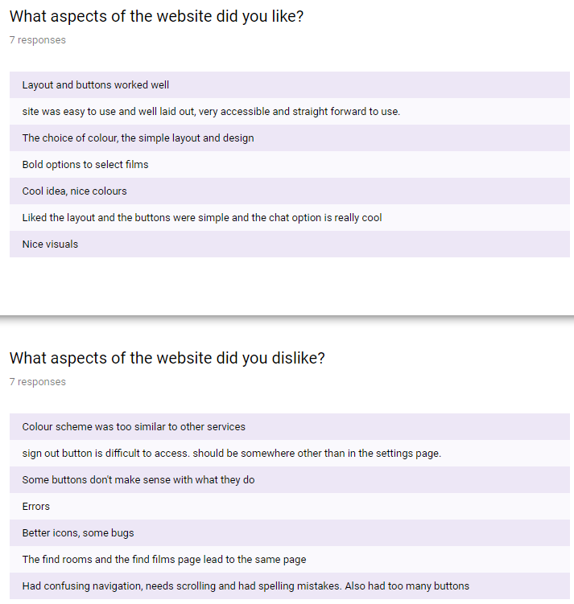
Usability Testing
Here is some evidence of the usability tests that were performed...
Qualitative Survey Test results:
Notes:
Ciaran

Slide 29
Usability Testing
Here is some evidence of the usability tests that were performed...
Quantitative Survey Test results:
81.2% average rating
A rank usability
Notes:
Ciaran

Slide 30
A/B Testing
What was our research question?
For our testing, we wanted to test if users would prefer using video players similar in style to other websites or a new design.
What were our two conditions?
Two full screen video players created, one with our own design and another similar in style to a Youtube video player. (The independent variables)
Participants were then asked to perform a series of task under a time limit, and offer their thoughts on what video player they preferred. (The dependent variables)
Where was the test conducted?
Tests were conducted in a quiet environment, at a desk with a large monitor.
Notes:
Mention dependent variables (ways of measuring the task) and independent variables (the player designs)
Ciaran

Slide 31
A/B Testing
How many participants did we recruit?
Ten participants took part in the testing, all with varying ages between 18 - 30 and computer literacy ability.
Which qualitative and quantitative data did we collect?
Times for how long participants took to find all the buttons was measured to assess how usable they found the system.
Participants were then asked to give their thoughts on each of the video players and state which one they preferred.
Counter Balancing poorly considered for testing, order of testing not monitored.
Notes:
BE MORE SPECIFIC ABOUT PARTICIPANTS, MAYBE PUT A TABLE, mention the lack of counter balancing
Ciaran

Slide 32
A/B Testing
Here is a sample of the data we gathered:
Full Screen time samples (Seconds):
9.15
15.20
7.56
9.82
Alternative Full Screen time samples (Seconds):
8.76
4.81
10.62
7.35
Notes:
Ciaran

Slide 33
A/B Testing - Thematic Analysis
What were the key themes?
Users liked familiar layouts, allowed them to find icons easily.
Users like clear icons, showing them where everything is.
Users didn’t like unfamiliar layout, with spread out buttons, despite transparency options.
Transparency wasn’t an issue for users.
How have the findings informed your final design?
The alternative video player has been used for the final iteration.
This is due to strong feedback, with participants finding it more accessible.
Notes:
NEED TO SHOW OFF QUESTIONNAIRE DATA IN ORDER TO SHOW KEY THEMES
Ciaran

Slide 34
Final Prototype
We will now demonstrate our final high-fidelity prototype
https://xd.adobe.com/view/b8da7366-dcb4-4b71-55f3-97f5b1bf8245-ceeb/
Notes:
Talk about what changes were made to the prototype after the thematic analysis. Don’t forget to show off the final items.
Ciaran

Slide 35
Going Forward
What updates would we make going forward?
Implement a ‘Big Icon Mode’ into the High Fidelity Prototype.
Color Blind Mode Option (Introduce a number of different Color Schemes to suit different color blindness)
Conduct more testing with peripheral devices like Tobii iXs (eye tracking camera).
What would we do differently next time?
Look into more High-Fidelity Prototyping software, ideally looking for software that allows the implementation of video player.
Spend more time developing the High-Fidelity prototype.
Use more testing methods using media (e.g. interviews, video recordings)
Notes:
Ciaran

Slide 36
Contributions
Name: | Simon Morson
Student ID: | 13158928
What was contributed: | Application Concept Comparison Research Identifying the Target Audience Accessibility Considerations Persona Concepts Hierarchical Task Analysis Diagrams Low Fidelity Prototypes Wireframe Prototypes
Notes:
Simon

Slide 37
Contributions
Name: | Ciaran O’Dwyer
Student ID: | 15111608
What was contributed: | Application Concept Creating the Personas Developing the High Fidelity Prototype Usability Testing A/B Testing Thematic Analysis Developing the Final High Fidelity Prototype Card Sorting
Notes:
Ciaran

Slide 38
Questions?

Slide 39
References
https://drive.google.com/open?id=1kbRlERcm75ybKHSOIGB_g-T0YI-2yZIL#
https://docs.google.com/document/d/12_dRVArkStOtG0PRvvxkTIsfBHXvQgDktoovk0FtPtg/edit?usp=sharing

